Slide 1
New Techniques for Entity Extraction of Cyber Security Concepts
Acknowledgements:
This material is based on research sponsored by: the Department of Homeland Security (DHS) Science and Technology Directorate, Cyber Security Division (DHS S\&T/CSD) via BAA 11-02; the Department of National Defence of Canada, Defence Research and Development Canada (DRDC); the Dutch Ministry of Security and Justice; and the Department of Energy (DOE).}\blfootnote{The views and conclusions contained herein are those of the authors and should not be interpreted as necessarily representing the official policies or endorsements, either expressed or implied, of: the Department of Homeland Security; the Department of Energy; the U.S. Government; the Department of National Defence of Canada, Defence Research and Development Canada (DRDC); or the Dutch Ministry of Security and Justice.

Slide 2
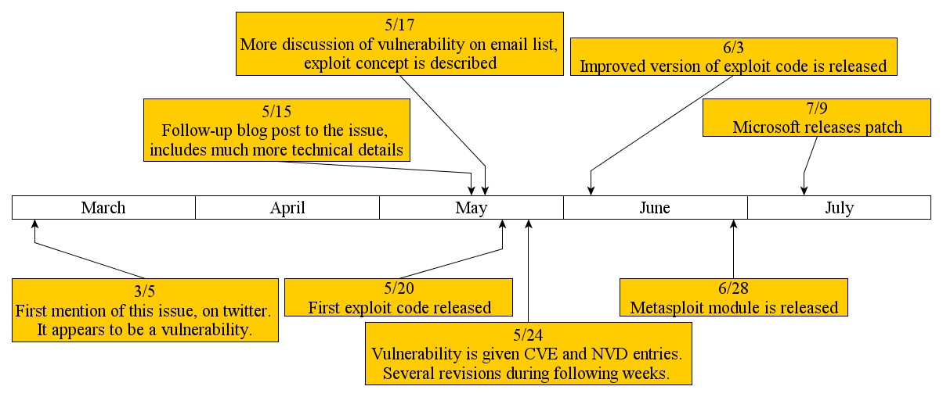
Enter Natural Language Processing
Want to automatically identify and extract important information from text!
Compelling example (Thanks Mike!):

Slide 3
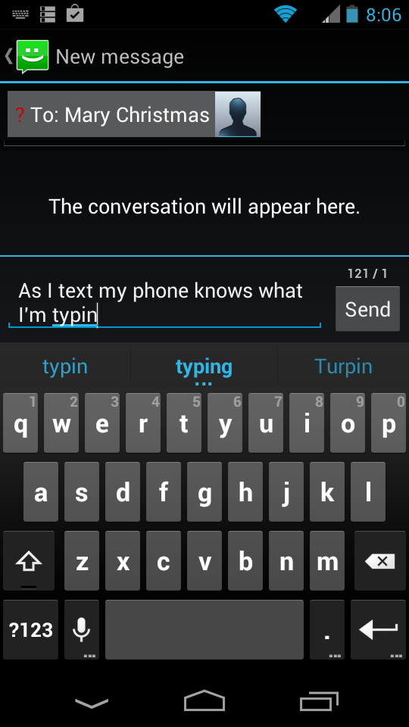
Natural Language Processing (NLP)
“Where Machine Learning meets Linguistics”
Use heuristic rules, probability, & computational tools to understand human language
Computational Linguistics = Natural Language Processing
(in my vernacular they are the same)
Examples
  Machine Translation
  Language Modeling
  Information Extraction
  Part of Speech Tagging
  Parse Trees
  Topic Modeling
  Text Summarization
  Sentiment Analysis
  …

Slide 4
Our Approach
Use Supervised Entity Extraction to identify and classify concepts of interest.
  “Automatically” created a training corpus with security-related labels
  Used a Maximum Entropy Model with history-based features
  Averaged Perceptron for training
  Greedy Tagging
Use semi-supervised techniques
  Not discussed today
Goals/Outline of the Talk
Introduction to ML techniques in Entity Extraction
Give some details of how we used them in our approach
Theme: NLP Machine Learning is thoroughly developed. Now, how to deploy these techniques to specialize applications?

Slide 5
Entity Extraction
Automatically Identifying & Classifying Concepts in Text
Also known as “Named Entity Recognition”
Example
Input
Output
George Washington’s ancestors were from Sulgrave, England; his great-grandfather, John Washington, had emigrated to Virginia in 1657.
George Washington’s ancestors were from Sulgrave, England; his great-grandfather, John Washington, had emigrated to Virginia in 1657.
person
place
person
place
date

Slide 6
Entity Extraction
Automatically Identifying & Classifying Concepts in Text
Example
Input:
Output
Microsoft Internet Explorer 6 & 7 does not properly handle objects in memory, which allows remote attackers to execute arbitrary code by accessing a deleted object, aka “OnReadyStateChange Remote Code Execution Vulnerability”.
Microsoft Internet Explorer 6 & 7 does not properly handle objects in memory, which allows remote attackers to execute arbitrary code by accessing a deleted object, aka “OnReadyStateChange Remote Code Execution Vulnerability”.
sw.vendor
sw.product
sw.versions
Vuln.relevant
Vuln.relevant
Vuln.relevant
Vuln.relevant

Slide 7
Part of Speech Tagging
Same Problem?
Example
Input
Output
The Volunteers should beat Michigan and advance in the tournament!
DT PN VB VB PN CC VB PP DT NN
The Volunteers should beat Michigan and advance in the tournament!

Slide 8










(Supervised) Sequential Labeling Problem
Generalization & Formalization
Given a fixed vocabulary,
Given a fixed set of labels,
Given a training set
  Each a sentence, so
  Each a tag sequence, so
Must produce a function which takes in a sentence and outputs labels (or tags)
Part of Speech Labels
Security Domain Labels
NN - noun
PN – proper noun
DT - determiner
JJ - adjective
VB – verb
CC – conjunction
PP – preposition
…
Sw.product
Sw.vendor
Sw.version
Sw.language
Sw.symbol
Vuln.relevant
Vuln.name
O – (No label)

Slide 9



Sequential Labeling Solution
Probabilistic Modeling
Pick probability model
Estimate
Set
  In other words, for sentence , choose the sequence of labels that is most likely.
Models | Type | Training Time | Performance
Hidden Markov Model | Generative | Fast | Least Accurate
History-Based Maximum Entropy Model | Discriminative | Medium | Medium
Global Maximum Entropy Model (Conditional Random Field) | Discriminative | Slow | Most Accurate

Slide 10
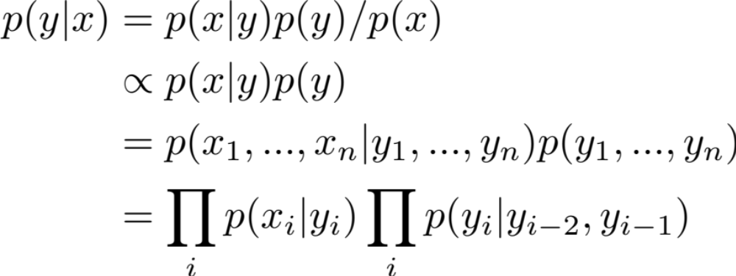
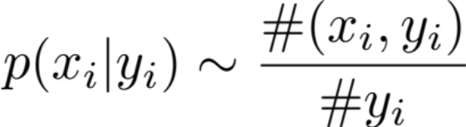
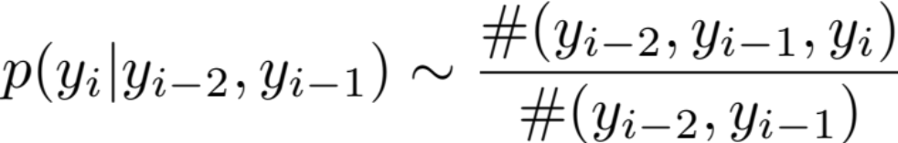
Hidden Markov Model (HMM)
A Crash Course
Recall Bayes’ Rule:
Estimate
Estimate
(denominator’s just a constant)
(independence & order 2 Markov assumption)
(just counting ---> fast!)
(just counting ---> fast!)

Slide 11




Hidden Markov Model (HMM)
A Crash Course
Parameters are estimated via counting (so very fast!)
Only takes into account previous two tags and current word (so not very accurate!)
Generative because is estimated
  We can now generate the observed sentence
  Sample (we know )
  Sample (we know )
Want to take into account more than previous two labels and the current word!!
Enter: Maximum Entropy Model

Slide 12
More Robust Features
Consider the following
Want to estimate
To decide ?? = PN (Proper Noun), it could be helpful to know:
  Current word is capitalized
  Next word is not capitalized and previous word is a verb
  Previous word ends in “ing”
  Word “and” appears anywhere in sentence
  …
DT PN VB VB ??
The Volunteers should beat Michigan and advance in the tournament!

Slide 13
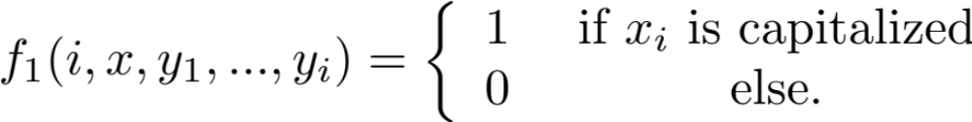
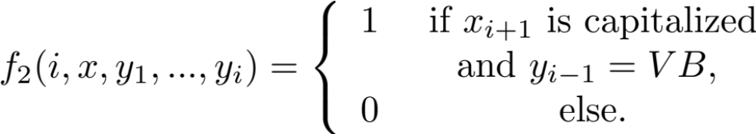



Feature Functions
Create feature functions, e.g.
For each “history” , and current label, we get a binary feature vector
DT PN VB VB ??
The Volunteers should beat Michigan and advance in the tournament!

Slide 14
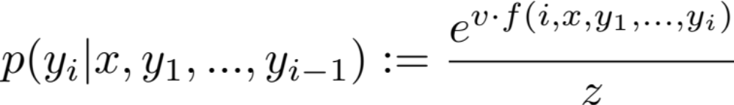
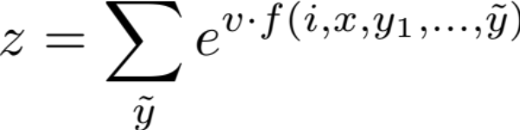
Cook-Up a Probability from Feature Vectors
Called a Maximum Entropy Model (MEM), or a Log-Linear Model
If features only depend on current and previous labels, it’s “History Based”.
HMM can be realized from MEM by choosing features that only depend on the current word, and the previous labels.

Slide 15

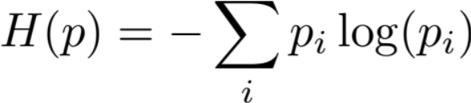
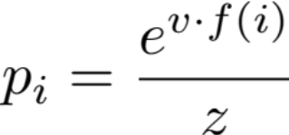
Why is It Called “Maximum Entropy”?
Want to only bias probability model by the observations in training data.
Definition: Given a discrete probability distribution, , the Entropy is
Maximizing entropy ensures the probability mass is spread evenly (unbiased)
Idea: Maximize entropy in the presence of constraints given by observed features (Lagrange Multiplier Problem).
Result:
Notes:
EXAMPLE: 6 sided die, 100 rolls, only know 50 of them were 3! How to make a probability distribution? Def. Want p(3)=.5, and want p(j)=1/10 for other 5 sides.

Slide 16
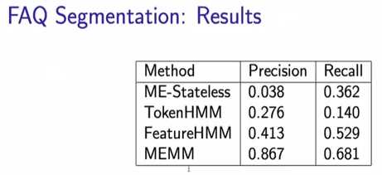
Some Results from Literature
“MEM better performance than HMM”
McCallum 2000 paper
FAQ website’s
Task is to put labels “Question”, “Answer”, “Header” on lines
ME-Stateless is MEM, but only features depending on current word
Feature HMM translated a sentence into a sequence of features, then HMM
Snippet from Collins’ coursera.org course

Slide 17

MEM Tagging & Training
✔
Choose Features
Define
How to train the model / fit the model / learn the parameters
How to tag a sentence?
✔

Slide 18







Decoding with History Based Models
How to Tag a Sentence
Direct Search:
  For a sentence of length n, , and m labels, , then finding the “best” tag sequence is
Greedy Decoding:
  Choose the most likely , then the most likely , …
  Not guaranteed to give the most likely total sequence!
Viterbi Decoding: Recovers “best” tag sequence in (for histories of length k)
  Dynamic programming trick: store calculated probabilities at each word.
  Then “walk” backward though sentence to construct the sequence

Slide 19



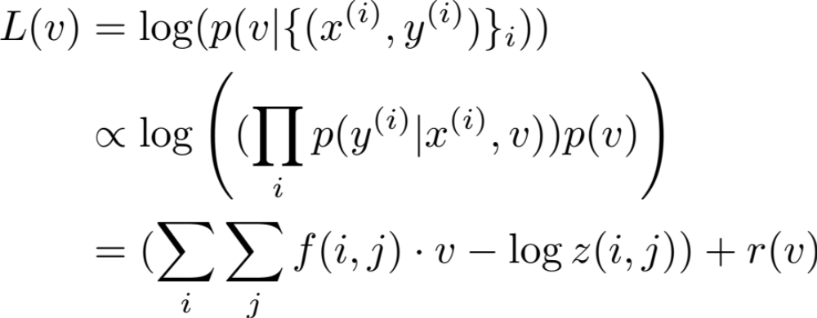
Training History Based Models
How to Learn Parameters
Maximum Likelihood Estimation (MLE)
  Choose most likely in light of training data
  In practice, maximize
  Easy to prove is concave
  Use gradient ascent methods, e.g. LBFGS
  , the log of the prior is the “regularization term”
  The first, linear term is
  where the name
  “Log Linear Model”
  originates
  Medium computational
  speed

Slide 20






Training History Based Models
How to Learn Parameters
Perceptron:
  Initiate
  Iterate through training set
  At example tag using current . Say given tag is .
    If keep unchanged, & go to next training example.
    If replace with
  Guaranteed to converge in case of linearly separable data
Averaged Perceptron:
  Run the “vanilla” perceptron
  Keep track of each intermediate and how many correct labels each provides
  Return the weighted average vector

Slide 21
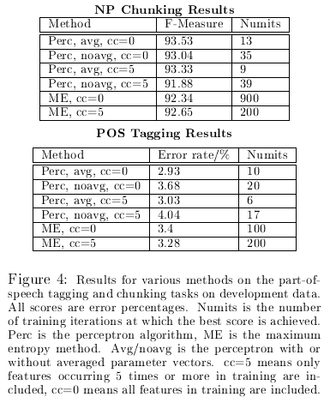
Some Results from Literature
Collins’ 2001 paper
Averaged Perceptron wins!

Slide 22
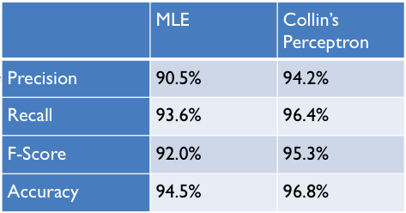
MLE and Perceptron Results
Our tests with labels “1” and “0”s
Both were slow, not as accurate as Ave. Perceptron

Slide 23
Global Models
Features Can Depend on Previous & Future Tags
Features can depend on previous and future labels
  Intuitively, better feature selection implies better performance
Must tag a whole sentence at a time!
Cannot use Viterbi! Cannot use Greedy Decoding!
  Intuitively, slower
Also called “Conditional Random Fields”
Models | Type | Training Time | Performance
Hidden Markov Model | Generative | Fast | Least Accurate
History-Based Maximum Entropy Model | Discriminative | Medium | Medium
Global Maximum Entropy Model | Discriminative | Slow | Most Accurate

Slide 24
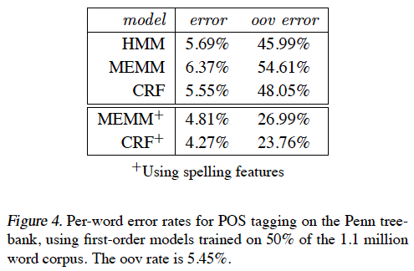
Some Results from Literature
Lafferty 2001 paper, part-of-speech tagging results
Oov = out of vocabulary words

Slide 25
Phew! Done with Entity Extraction Background
What Was Our Problem Again?
Want to find and classify security-related entities in text!
Our Approach
Use Supervised Entity Extraction to identify and classify concepts of interest.
  “Automatically” created a training corpus with security-related labels
  Used a Maximum Entropy Model with history-based features
  Averaged Perceptron for training
  Greedy Tagging
Use semi-supervised techniques
  Not discussed today
✔
✔

Slide 26
“Auto-labeling”: Creating a Training Corpus
Method
Found structured sources (databases) with related text.
  Used structured fields to label identical strings in related text
Heuristic rules to label entities in text
Created a gazetteer of “relevant vulnerability terms”
  Common Weakness Enumeration (CWE) categorizes vulnerabilities. Most frequent phrases in vulnerability descriptions were hand-picked and labeled.
Sources
National Vulnerability Database (NVD)
Microsoft Bulletin
Metasploit Module

Slide 27
“Auto-labeling”: Creating a Training Corpus
Example: National Vulnerability Database (NVD) record with annotated description
ID #: CVE-2012-0678
Description: Cross-Site Scripting (XSS) vulnerability in Apple Safari before 6.0 allows remote attackers to inject arbitrary web script or HTML via a feed :// URL.
Software Vendor: Apple
Software Application: Safari
Versions Affected: 1.0.0, … , 5.1.7
CWE Type: Cross-Site Scripting
...

Slide 28
“Auto-Labeling”: Creating a Training Corpus
Example: National Vulnerability Database (NVD) record with annotated description
ID #: CVE-2012-0678
Description: Cross-Site Scripting (XSS) vulnerability in Apple Safari before 6.0 allows remote attackers to inject arbitrary web script or HTML via a feed :// URL.
Software Vendor: Apple
Software Application: Safari
Versions Affected: 1.0.0, … , 5.1.7
CWE Type: Cross-Site Scripting
...
Vuln.relevant
Sw.vendor
Sw.product
Sw.version
Vuln.relevant
Vuln.relevant

Slide 29
“Auto-Labeling”: Creating a Training Corpus
Total List of Domain Specific Labels
Sw.product
Sw.vendor
Sw.version
Sw.language
Sw.symbol
Vuln.relevant
Vuln.name
O – (No label)
Also used “IOB” tags to mark multiple term entities.
Example:
  “… Internet Explorer was …”
  “… Internet Explorer was …”
  “… Internet Explorer was ...”
B
I
O
(First, IOB labels identify entities)
B
sw.product
I
sw.product
O
(Next, domain labels classify entities)

Slide 30
Auto-Labeled Corpus Stats
Over 850,000 words
Results on a random subsample:
Precision = #(correctly labeled) / #(labeled)
  Precision is the probability something was correctly labeled given it was labeled.
Recall = #(correctly labeled)/ #(should be labeled)
  Recall is the probability something was correctly labeled given it should have been
F1 = Harmonic Mean (P,R) = 1/ave(1/P, 1/R) = 2PR/(R+P)
 | P | R | F1
NVD | .99 | .80 | .89
MS-Bulletin | .99 | .75 | .866
Metasploit | .95 | .54 | .69

Slide 31
Similar to “Auto-Labeling” Papers
Bellare et al 2007
  Use BibTeX to segment corresponding citations
Seymore et al 1999
  Use BibTeX entries to label headers of papers
Craven & Kumlien 1999
  Sentence related to a database
  Label a sentence as positive or negative

Slide 32
Our Approach
Use Supervised Entity Extraction to identify and classify concepts of interest.
  “Automatically” created a training corpus with security-related labels
  Used a Maximum Entropy Model with history-based features
  Averaged Perceptron for training
  Greedy Tagging
✔
✔
✔

Slide 33
IOB Labels
Used NLTK to apply part-of-speech tags
Features:
  Unigram features for
    Previous 2, current, and following 1 word
    Previous 2, current, and following 1 part-of-speech tag
    Previous 2 and current IOB-tag
  Bigram features for
    Previous 2 IOB-tags
    Previous IOB-tag & current word
    Previous part-of-speech tag & current word
  Regular Expressions for identifying
    1nitial digit, inter1or digit, snake_case, camelCase, Initial capital, & punctuation!
    Used on previous 2, current, and following 2 words

Slide 34
Domain Labels
Used NLTK to apply part-of-speech tags
IOB-Tags already applied
Features:
  Unigram features for
    Previous 2, current, following 1 word
    Previous 2, current and following 1 part-of-speech tag
    Previous 2 and current IOB-tag
    Previous 2 domain labels
  Bigram features for
    Previous 2 domain labels
    Previous domain label & current word
    Previous IOB-tag & current word
    Previous part-of-speech tag & current word
  Gazetteer features for
    Sw.product
    Sw.vendor
  Regular Expressions for identifying
    1nitial digit, inter1or digit, snake_case, camelCase, Initial capital, & punctuation!
    Used on previous 2, current, and following 2 words

Slide 35
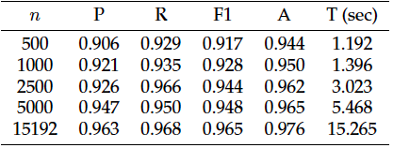
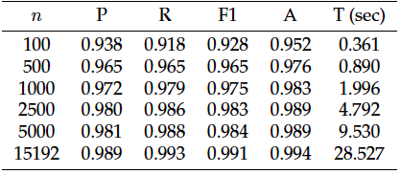
Performance
IOB Results
Results:
  5-fold repeated subsampling
  80/20% train/test sets
  n = # NVD text descriptions
  OpenNLP implementation results given
  Time is “clock-time” on Macbook 2.3Ghz I7, 8GB, 256GB flash
NVD Results

Slide 36
Some Results from Literature
Joshi et. al 2013
Almost same problem
Hand-labeled corpus
CRF (global model)
Precision | Recall | F1
.837 | .764 | .799

Slide 37
Thanks!
Collaborators:
  Corinne Jones (PSU Intern)
  Mike Iannacone
  Kelly Testa
  John Goodall (PI)
Funding
  DHS

