Slide 1
Welcome and Overview

Slide 2
LOCAL SUB INTRO (Optional)

Slide 3
Course Goals
Provide a jumpstart on development for Azure and Office 365
Understand the options for your platform of choice
  Windows, Linux, OSX
What is Azure? What is the Microsoft Cloud?
CODE, CODE, CODE

Slide 4
Quick Introduction
Who am I?
Who are you?
  Company and role
  Experience with cloud
  What is your platform of choice?
  What are you looking to learn?
What is Azure?

Slide 5
Microsoft Cloud
Secure Productive Enterprise &
Operations Management + Security
Cortana Intelligence Suite
Office 365
Dynamics
Azure
PRODUCTIVITY
BUSINESS
APPS
SECURITY &
MANAGEMENT
DATA &
INTELLIGENCE
APPLICATION
INNOVATION

Slide 6
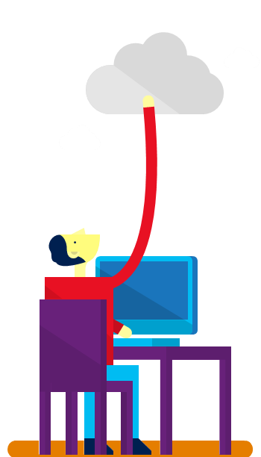











7+ billion
worldwide queries each month
50+ billion
minutes of connections handled each month
250+ million
active users
85%
Fortune 500 users
2.4+ million
emails per day
30+ trillion
objects stored
3.5+ million
subscribers
48+ million
users in 41 markets
50+ million
active users
400+ million
active users
18+ billion
Active Directory authentications per week
200+ Cloud Services
1+ billion customers · 20+ million businesses · 90+ markets worldwide

Slide 7

40
Azure regions
More than any other cloud provider
RECENTLY LAUNCHED:
US Gov: US Gov Texas and US Gov Arizona
NEWLY ANNOUNCED:
France: France Central and France South
Africa: South Africa North and South Africa West
Notes:
At the core of Azure is its global infrastructure that spans 40 regions worldwide. We have the largest footprint of any cloud provider – 2X that of AWS.
https://azure.microsoft.com/en-us/regions/

Slide 8
Azure Momentum
194 billion
External Requests made to Azure App Service
340 billion
Azure SQL query requests processed/day
>90%
of Fortune 500 use Microsoft Cloud
750 million
Azure Active
Directory users
188 billion
Hits to websites run on
Azure Web App Service
Notes:
We’ve had incredible momentum in the last year with over 90% of Fortune 500 companies using the Microsoft Cloud.

Slide 9




Azure covers 59 compliance offerings
Azure has the deepest and most comprehensive compliance coverage in the industry
Global
ISO 27001:2013
ISO 27017:2015
ISO 27018:2014
ISO 22301:2012
ISO 9001:2015
SOC 1 Type 2
SOC 2 Type 2
SOC 3
CSA STAR Certification
CSA STAR Attestation
CSA STAR Self-Assessment
US Gov
FedRAMP High
FedRAMP Moderate
DoD DISA SRG Level 5
DoD DISA SRG Level 4 DoD DISA SRG Level 2 DFARS
DoE 10 CFR Part 810 NIST SP 800-171
FIPS 140-2
Section 508 VPATs
NIST CSF ITAR
CJIS
IRS 1075
Industry
PCI DSS Level 1
GLBA
FFIEC Shared Assessments FISC (Japan)
HIPAA BAA
HITRUST 21 CFR Part 11 (GxP) MARS-E
IG Toolkit (UK)
NEN 7510:2011 (Netherlands)
FERPA
CDSA
MPAA
FACT (UK)
Regional
Argentina PDPA
Australia CCSL / IRAP
Canada Privacy Laws China GB 18030:2005 China DJCP (MLPS) Level 3
China TRUCS / CCCPPF
EU ENISA IAF
EU Model Clauses EU – US Privacy Shield Germany IT-Grundschutz workbook
India MeitY
Japan CS Mark Gold
Japan My Number Act Netherlands BIR 2012 New Zealand Gov CIO Fwk
Singapore MTCS Level 3
Spain ENS
Spain DPA UK G-Cloud
Notes:
May-2017: Azure compliance coverage includes 59 offerings. Latest additions: DFARS, DoE 10 CFR Part 810, and NIST CSF

Slide 10



Build apps faster and easier - IAAS
VM
Containers
Service Fabric
Other
Legacy applications, no change
Efficiency and speed
Always-on, scalable, distributed applications
Cloud Foundry, OpenShift, Apprenda, Jelastic, etc.
Lift and shift
Improved
DevOps
Hyperscale
(e.g. IOT)
Third-party
frameworks
Notes:
[The 1,000ft View - PaaS services drill down]
Objective:
Define what constitutes the Azure application platform. What are the main services developers need to think about.
Key talking points:
Build on the OS: Virtual Machines are the “base unit” for moving workloads to the cloud. The Azure Container Service provides a really fast way to get containers into production with a choice of popular open source container orchestration solutions: DC/OS or Docker Swarm
Service Fabric: is a platform that developers and ISVs can use to build and manage custom microservice-based applications at cloud scale and with 24x7 availability. Microservices are an architectural approach based on fine-grained, loosely coupled services that can enable advanced developer agility
Other PaaS: all PaaS runs great on Azure! Azure supports the leading third-party PaaS framework providers like Cloud Foundry and OpenShift.

Slide 11


Build apps faster and easier - PAAS
< DEVELOPERS
NON-DEVELOPERS >
App service
Functions
Logic apps
Power apps
Web, mobile, and API apps
Serverless compute
Workflow & Integration
Self-service
Web and mobile
Event-driven microservices
LOB integration and hybrid apps
No-code apps
Notes:
[The 1,000ft View - PaaS services drill down]
Objective:
Define what constitutes the Azure application platform. What are the main services developers need to think about.
Key talking points:
App Service: is a set of services that has everything you need to build apps that target both web and mobile clients from a single app back end. Supporting a range of language options—.NET, Node.js, Java, PHP, and Python—it consists of Web Apps, Mobile Apps, Logic Apps, and API Apps.
Functions: provides serverless, compute for event-driven solutions that extends the existing Azure application platform with capabilities to implement code triggered by events occurring in other Azure services, SaaS products (like Office365 and Salesforce.com), and on-premises systems.
Cloud Services: was the original Microsoft platform as a service (PaaS) service launched in 2010. Inspired by the needs of developers, Cloud Services enabled them to easily deploy .NET applications, taking advantage of cloud infrastructure like Virtual Machines and Virtual Networks without having to manage the low-level details and configuration of Windows Server and the underlying infrastructure.
Other PaaS: all PaaS runs great on Azure! Azure supports the leading third-party PaaS framework providers like Cloud Foundry and OpenShift.

Slide 12
Azure & Office 365 2-Day DevCamp

Slide 13
Course Agenda
Module 1
Module 2
Module 3
Module 4
Module 5
Module 7
Setting up your developer environment
Building modern cloud apps
Identity with Azure AD and Office 365 APIs
DevOps with Azure and Visual Studio Team Services
Module 6
Cloud Building Blocks
ARM and Infrastructure as Code
Monitoring applications with App Insights

Slide 14
Hands on labs
HOL 1
HOL 2
HOL 3
HOL 4
HOL 5
Setting up your developer environment
Building modern cloud apps
Identity with Azure AD and Office 365 APIs
DevOps with Azure and Visual Studio Team Services
Infrastructure as code with Azure Resource Manager (ARM)
HOL 6
Monitoring applications with App Insights

Slide 15
Day 1 – Detailed Agenda
9:00 AM – 9:30
Overview
9:30 – 10:15
Tools and developer environment overview
10:15 – 10:45
HOL 1 - Tools and Developer Environment Setup
10:45 – 11:00
Break
11:00 -11:30
HOL1 - Tools and Developer Environment Setup (Cont'd)
11:30 - 12:15 PM
Modern Cloud Apps + Demo
12:15 -1:00
Lunch
1:00 - 2:00
HOL 2 - Modern Cloud Apps
2:00 - 2:15
2:15 - 3:15
Identity and Office365 APIs Overview + Demos
3:15 - 4:45
HOL 3 - Identity and Office365 APIs
4:45 - 5:00
Break
Q&A

Slide 16
Day 2 – Detailed Agenda
9:00 AM-9:15
10:00 - 10:15
10:15 - 11:15
12:00 - 1:00
Recap
9:15 - 10:00
Monitoring Lecture + Demo
Break
2:15 - 3:00
HOL 5 - Infrastructure as code (ARM)
2:00 - 2:15
Lunch
1:00 - 2:00
Infrastructure as code (ARM) + Demo
HOL 4 - Continuous integration with VSTS
11:15 - 12:00 PM
Break
DevOps with Azure Services + Demo
3:00 - 4:00
HOL 6 - Monitoring applications with App Insights
Q&A
4:00 - 4:45
Cloud Building Blocks Containers (Docker, ACS) and other
4:45 - 5:00

Slide 17
HOL Agenda
HOL 1 - Tools and Developer Environment Setup
HOL 2 - Modern Cloud Apps
HOL 3 - Identity and Office365 APIs
HOL 4 - DevOps Continuous integration
HOL 5 - Infrastructure as code
HOL 6 - Monitoring

Slide 18
Intro to Scenario
City Power & Light is looking to use cloud capabilities
Would like to allow field workers the ability to capture incidents
Would like to provide photo upload capability
Would like to consume PaaS services on Azure

Slide 19
Demo
City Power and Light
Notes:
Demo steps
Show site
Login with Azure AD
Create new incident
Show dashboard
Show profile

Slide 20
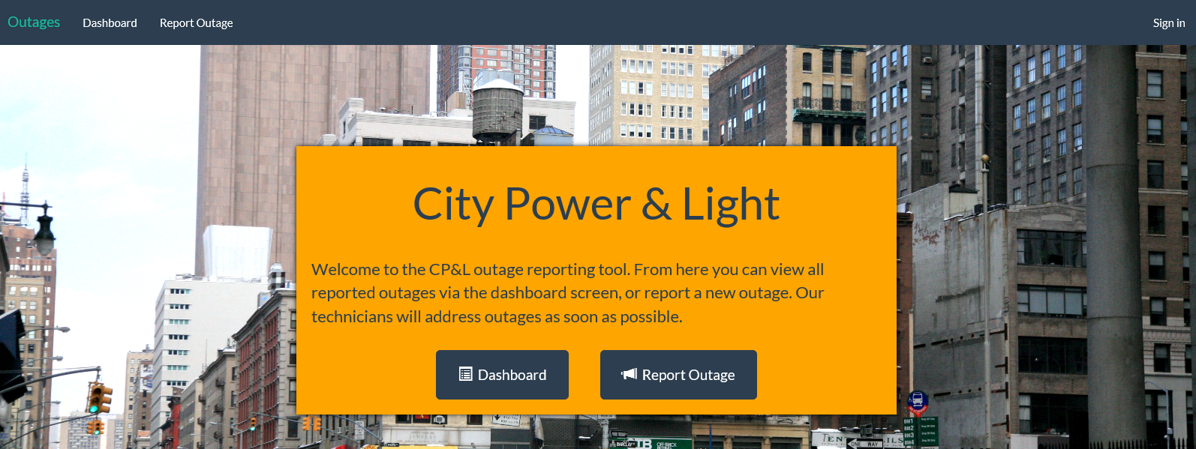
City Power & Light Outage Incident Tracker

Slide 21
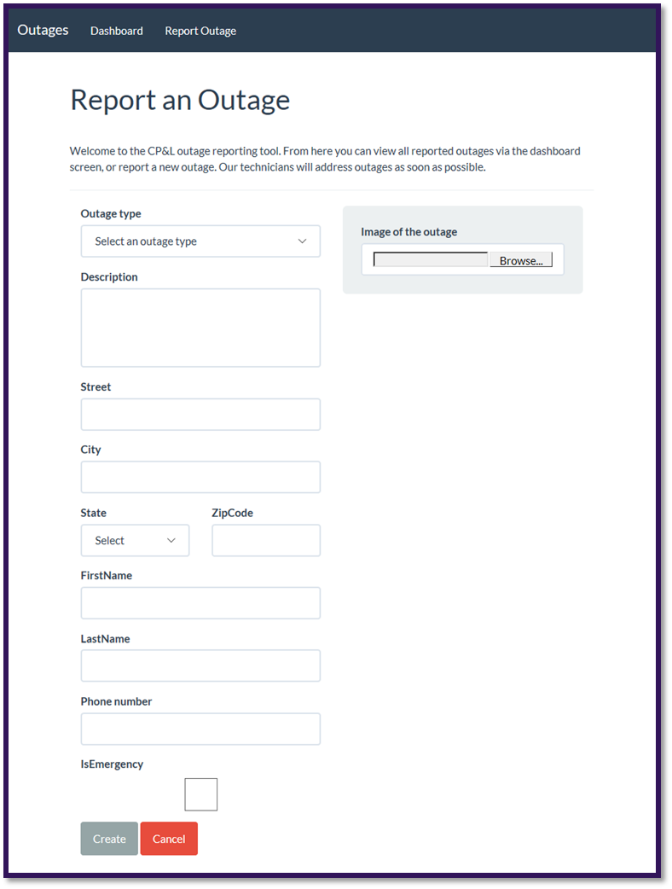
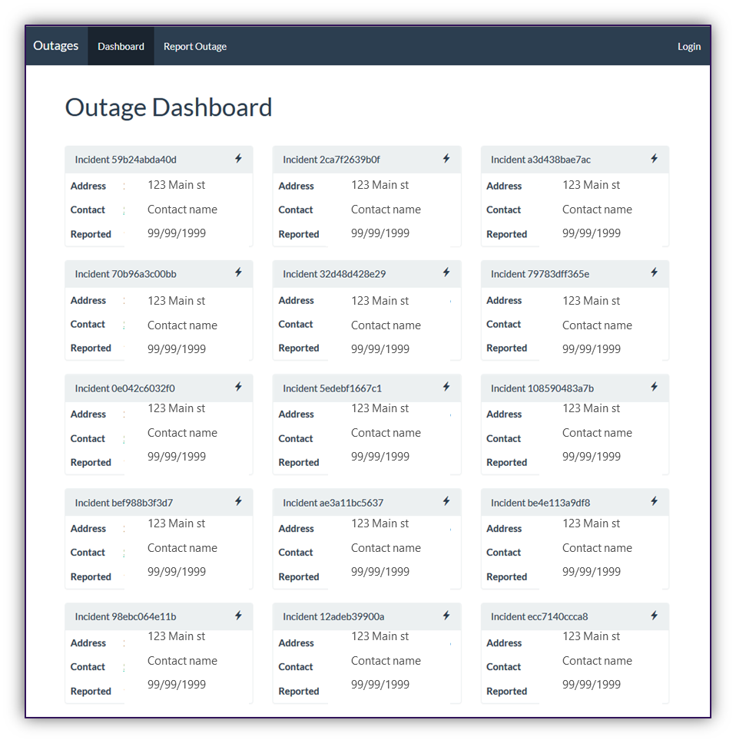
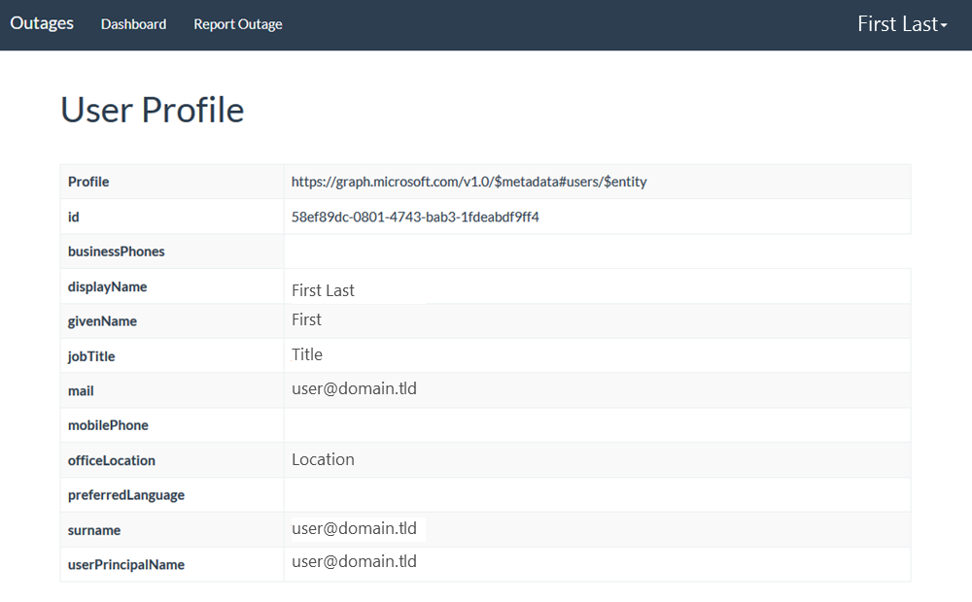
Screenshots

Slide 22


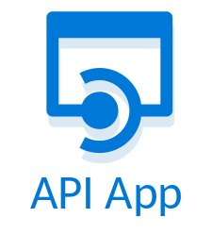
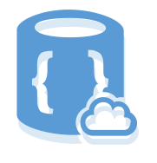


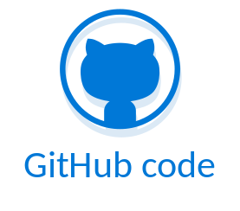
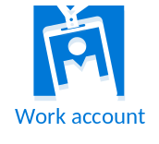


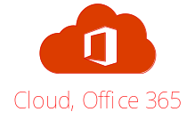

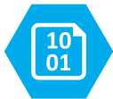
City Power & Light App Architecture
START
8
3
4
AZURE DOC DB
AZURE API APP
AZURE CACHE
1
Dashboard
WEB SITE
New Incident
Incident Tracker
Email
Images
6
AZURE QUEUE
2
7
5
9
AZURE BLOB STORAGE
AZURE FUNCTION
AZURE AD
O365 APIs

Slide 23
Components Covered in this Course
Azure
  Azure Resource Manager
  Virtual Machines (Windows)
  Azure AD
  Web Applications
  API Apps
  Redis Cache
  Document DB
Office 365
  Microsoft Graph API (users, OneDrive for Business, Skype for Business)
Visual Studio Team Services
  Source Control integration (GIT)
  Continuous Integration & Delivery
Containers
  Docker
  Azure Container Service

Slide 24
Hands On Labs

Slide 25
HOL 1: Setting up your developer environment
Create O365 Developer Tenant
Connect Azure subscription (Pass or Trial)
Take prepared image or run locally, walk through the tools that are available for your platform
  .NET, Node.JS, Java | Windows. Mac OSX
Run ARM Template to scaffold out resources

Slide 26
HOL 2: Building modern cloud apps
Starting with provisioned resource group
Select front end app (.NET/Node.js/Java)
Connect to deployed API
Add blob storage
Add queueing
Add Redis cache
Stretch: Image resizing with Azure Functions

Slide 27
HOL 3: Identity with Azure AD and Office 365 APIs
Create AAD Application
Add authentication to app
Add profile page
Add graph API call to get user data for profile page
Populate first & last name of the new incident form with first name & last name from Graph/token
Send Email via Graph on new incident creation
Stretch: Add calendar event on new incident creation

Slide 28
HOL 4: DevOps with Azure and VSTS
Create Visual Studio Team Services (VSTS) Online account
Create Git repository
Clone Git repo locally
Push code into VSTS
Create CI pipeline for build
Ends with published artifacts

Slide 29
HOL 5: Infrastructure as code with (ARM)
Create ARM template for web app in VS
Deploy using VSTS
Create 1 Production environment
Configure Continuous deployment

Slide 30
HOL 6: Monitoring applications with App Insights
Add App Insights resource to Azure
Add App Insights to application server side
  Monitor the API call
Add client side library
  Dashboard custom event to capture dashboard views
Create availability test that test the dashboard
Stretch - Create custom metric around the API call

