Slide 1
Azure DevCamp Identity and Office 365 APIs

Slide 2
Agenda
Identity Overview
OAuth 2.0 Primer
Azure AD and Office 365
The Microsoft Graph

Slide 3






Identity as the core of enterprise mobility
Simple connection
Windows Server
Active Directory
Other
directories
Self-service
Single sign-on
Azure
SaaS
Public
cloud
On-premises
Microsoft Azure Active Directory
Cloud

Slide 4
Azure Active Directory
Microsoft “Identity Management as a Service (IDaaS)” for organizations.
Millions of independent identity systems controlled by enterprise and government “tenants.”
Information is owned and used by the controlling organization—not by Microsoft.
Born-as-a-cloud directory for Office 365. Extended to manage across many clouds.
Evolved to manage an organization’s relationships with its customers/citizens and partners (B2C and B2B).
90%
of Fortune 500 companies use Microsoft Cloud (Azure, O365, CRM Online, and PowerBI)
Azure AD Directories
>10 M
More than
750 M user accounts on Azure AD
33,000
Enterprise Mobility + Security | Azure AD Premium enterprise customers
>110k
third-party applications used with Azure AD each month
>1.3 billion authentications every day on Azure AD
Every Office 365 and Microsoft Azure customer uses Azure Active Directory

Slide 5
Linking Office 365 and Azure
Log into Microsoft Azure subscription as administrator
Click on the Active Directory link
Click New>Active Directory>Directory>Custom Create
Select to Add an Existing Directory
Follow the steps to add an existing directory
Notes:
It’s not required to link the Office 365 Directory to an Azure subscription
for simply creating provider-hosted apps, but it makes life a bit easier
and opens up the ability to call into Office 365 from other applications.

Slide 6
What is OAuth 2.0?
Simple mechanism to grant a third party access to a user’s resources without sharing the user’s password
Cross platform app authorization
Internet Standard supported by Azure, Facebook, Google, Twitter, and more
Notes:
OAuth provides a simple mechanism for end-users to grant a third party access to their data and resources without sharing their passwords.
It also enables the user to grant access limited by scope and duration.

Slide 7


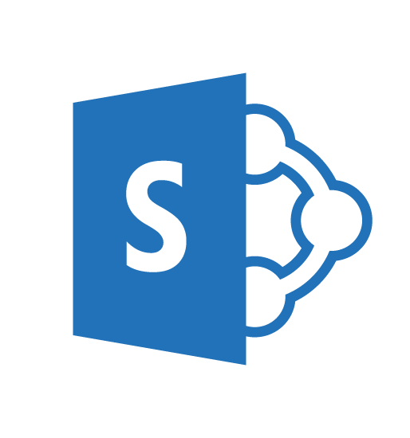
OAuth 2.0 Flow Office 365 APIs
Auth Code,
App Id, App Secret sent
User accesses web application
Access and Refresh
Tokens returned
Azure Web Site
(Client)
Access Token presented
Along with request
Response returned
Consent dialog displayed
Auth Code returned and
user redirected
Grant access using Consent Dialog
Redirected to AAD
End User
(Resource Owner)
Azure ACS
(Authorization Server)
SharePoint Online
(Resource Server)

Slide 8
Authentication Protocols
Browser
OpenID Connect
OAuth 2.0
Web Apps
Web APIs
Native app
OAuth 2.0
OAuth 2.0
Server app
Web APIs
OAuth2.0
Web APIs
OAuth 2.0

Slide 9
Auth2.0 Protocols
OAuth 2.0
Web APIs
Native/Mobile Apps
Web APIs
OAuth 2.0
Browser
OpenID Connect
Web Apps

Slide 10
Azure AD Applications

Slide 11
Azure AD Applications
Any application that authenticates with Azure AD must be registered in the Azure AD tenant
  Console apps, web apps, services, etc.
Applications in Azure AD are assigned credentials
  Client ID: similar to a user’s login / username
  Key / secret: similar to a user’s password
Created & managed using the Azure Portals
  Also managed using Azure’s PowerShell module / Azure CLI x-platform tool
See: https://azure.microsoft.com/en-us/documentation/articles/active-directory-authentication-scenarios/

Slide 12
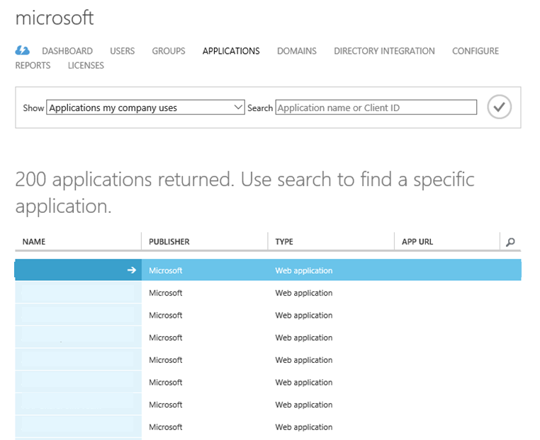
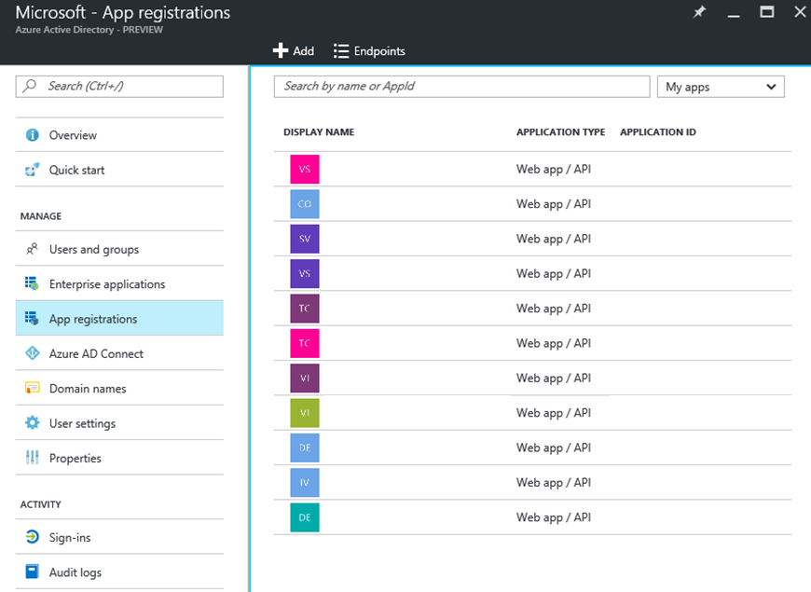
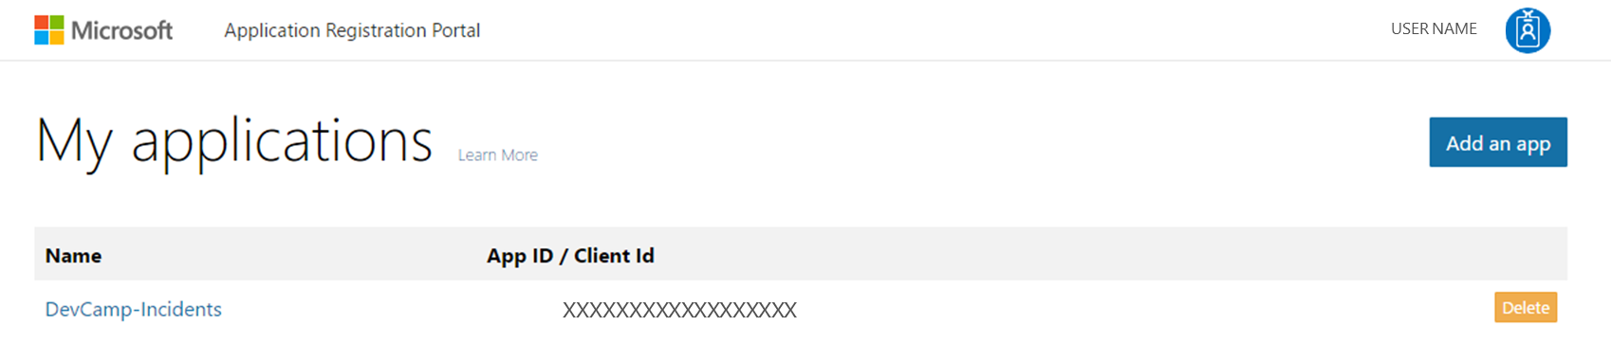
Registering Azure AD Applications
Three Options:
  Create Graph 1.0 AAD Applications from Classic
  Create Graph 1.0 New Ibiza portal (preview)
  Create Graph 2.0 Applications on apps.dev.microsoft.com
  Supports web applications & native applications

Slide 13
Comparing Graph 1.0 and 2.0
https://azure.microsoft.com/en-us/documentation/articles/active-directory-developers-guide/
https://azure.microsoft.com/en-us/documentation/articles/active-directory-v2-limitations/

Slide 14
Single vs. Multi-Tenant Applications
Single Tenant Apps
  Available to all users in your Azure AD directory
  Not available to users outside your Azure AD directory
  Typically internal apps for your organization’s users
Multi-Tenant Apps
  Just like single tenant apps except…
  Available to all users in any Azure AD directory
  Typically built by ISVs or as a SaaS offering

Slide 15
Application Permissions
Delegated Permissions
  User of the application consents application specific permission to
  act on the user’s behalf
  User must have permissions the app is configured for delegated permission
  Useful in User+App Authentication Scenarios (more later)
Application Permissions
  Apps have permissions
  Acts independent of user
  Must be registered

Slide 16
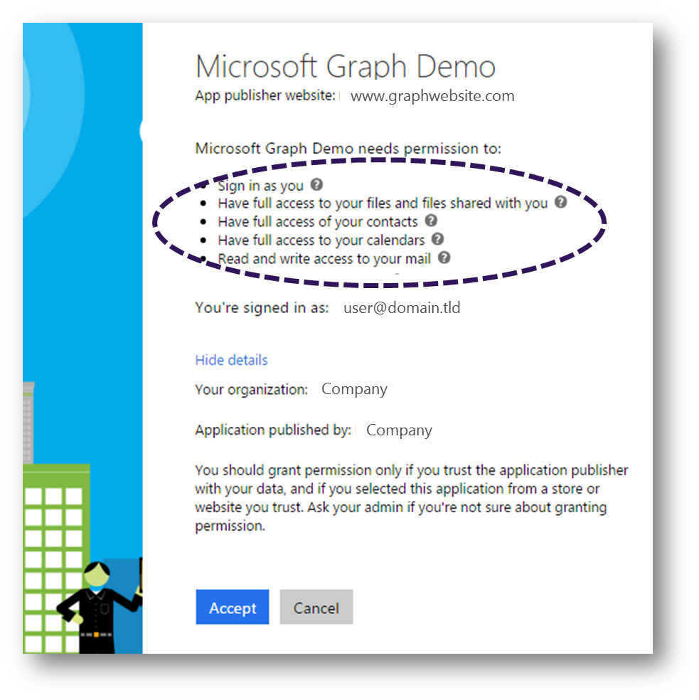
Consent
Single auth flow for accessing all O365 services
Admin and end-user consent
Secure protocol
  OpenID Connect and OAuth 2.0
  No capturing user credentials
  Fine-grained access scopes
  Long-term access through refresh tokens

Slide 17
Authorization flow
Authorization
Endpoint
Token
Endpoint
Application
Microsoft Graph API
Request authorization code
Sign-in via browser pop-up
Return authorization code
Redeem authorization code and acquire access token for Microsoft Graph
Return tokens
Call Microsoft Graph using the access token
Return Http Response

Slide 18
Authentication Options
Azure AD only
  Separate auth flow supports Azure AD accounts only
Live connect only
  Separate auth flow supports Azure AD accounts only
Azure AD and Microsoft Accounts (Preview)
  Converged auth flow supports Azure AD accounts and Microsoft accounts (LiveID - hotmail.com, etc.)

Slide 19
Microsoft Account + Azure AD
Many apps want to sign users in from both Microsoft account and Azure AD
Now in preview:
  Single endpoint, OpenID Connect and OAuth 2.0
  Single SDK
  Single end user sign in experience
  Single app registration experience
Works with Microsoft Graph
  Single API endpoint, business and consumer data

Slide 20
Differences in the converged model
No preregistration of permission scopes
  https://login.microsoftonline.com/common/oauth2/v2.0/authorize?client_id=123&scope=user.read mail.read...
Dynamic permission request
  https://login.microsoftonline.com/common/oauth2/v2.0/authorize?client_id=123&scope=files.read...
Separate endpoint for admin consent
  https:// login.microsoftonline.com/<tenantId>/adminconsent (might change)
Separate endpoint for splitting clouds
  https://login.microsoftonline.com/consumers/oauth2/v2.0/authorize?client_id=123&scope=files.read...
  https://login.microsoftonline.com/organizations/oauth2/v2.0/authorize?client_id=123&scope=files.read...

Slide 21
Authentication and authorization with Azure AD

Slide 22
OAuth 2.0 Tokens
Context Token
  Information about the Resources Owner and Client that can be used to get an Access Token later.
Refresh Token
  A token used to get an Access Token from the Authorization Server.
Access Token
  A token passed to the Resource Server authorizing the Client to access resources.
Authorization Code
  A code that can be used to register an app on-the-fly.
Notes:
In the OAuth 2.0 model, access to protected resources is done using access tokens —an object with a specific scope, lifetime, and other access attributes. OAuth access tokens are sometimes compared to valet keys. In the same way as a valet key gives restricted access to a car, allowing a valet to drive it but not open the trunk or the glove compartment, the access token allows a client application restricted access to a user’s data at a resource server via tokens issued by an authorization server in response to the user authorizing access.
With OAuth 2.0, a third-party application does not use the resource owner's credentials to access protected resources. Instead, the third-party application obtains an access token. Access tokens are issued to third-party clients by an authorization server with the approval of the resource owner. The client uses the access token to access the protected resources hosted by the resource server.

Slide 23
Bearer Tokens
OAuth 2.0 Access Tokens are unbound tokens
(a.k.a, “Bearer Tokens”)
  An Access Token can be used by any application that possesses it
  Always use SSL—OAuth design depends on it!
  Never expose tokens in JavaScript or allow them to be accessed by client-side debugging tools
  If an Access Token is compromised, damage is limited by expiration
  If a Refresh Token is compromised, damage is limited because the Client ID and Client Secret are required to get an Access Token from a Refresh Token.

Slide 24
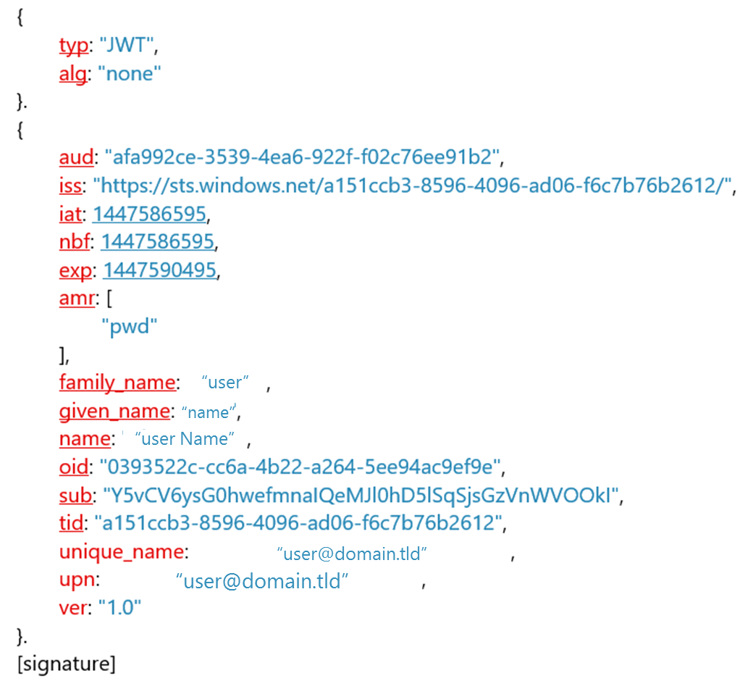
Tokens
result → success
token_type → Bearer
expires_in → 3599
scope → Files.ReadWrite Mail.Send User.Read
offline_access openid
expires_on → 1447590495
not_before → 1447586595
resource → https://graph.microsoft.com
access_token →eyJ0eXAiOiJKV1QiL…
refresh_token →AAABAAAAiL9Kn2…
id_token →eyJ0eXAiOiJK…

Slide 25
Authentication with Azure AD
All HTTP requests must include valid OAuth2 access token in the header
  AUTHORIZATION: Bearer <base64 encoded JWT token>
Application Types
  Browser
  Native or mobile client
  Device or app

Slide 26
Authenticating with Azure AD (.NET)
// usually https://login.microsoftonline.com
var aadAuthority = new UriBuilder(“https://login.microsoftonline.com”);
// credentials for the application
ClientCredential credential = new ClientCredential(AppId, AppSecret);
AuthenticationContext authContext =
new AuthenticationContext(aadAuthority.Uri.AbsoluteUri);
// authenticate user with Azure AD with specific Azure AD App for API resource
var aadAuthenticationResult =
await authContext.AcquireTokenAsync(“https://graph.microsoft.com”,
credential, userId);
var accessToken = aadAuthenticationResult.AccessToken;

Slide 27
Application Types:
User+App | App-Only

Slide 28
Application Type: User+App App
User authenticates with their Azure AD tenant credentials to use the application
Leverages delegated permissions
Required for some scenarios
  Deleting user accounts from Azure AD
  Actions need to be tracked to a specific individual

Slide 29
Application Type: App Only
Acts on behalf of & independent of user
No user involvement required
Scenarios
  Web app to query the graph
  Create objects in Office 365
  Scheduled services

Slide 30
OAuth Flows

Slide 31
Resource Owner Password Credentials Flow
User provides app username & password
App authenticates as the user
Enables: user + app authentication
Scenarios: native applications with interactive session
Spec: https://tools.ietf.org/html/rfc6749-section-1.3.3

Slide 32
Resource Owner Password Credentials Flow
Azure AD
Authorization
Endpoint
https://login.microsoftonline.com/
[..]/oauth2/authorize
Token
Endpoint
https://login.microsoftonline.com/
[tenantid]/oauth2/token
Endpoint
https://graph.microsoft.com
App
1. Request token (Client Id, Username, Password, resource=“https://graph.microsoft.com”)
2. Returns AAD Access Token(JWT)
3. Request token + AAD Access Token in Authorization Header (Client ID)
4. Returns Access Token(JWT)
5. Issue query with Access Token in Authorization Header

Slide 33
Client Credentials Flow

Slide 34
Client Credentials Flow
No user involvement required
App authenticates as the app; no user context
Enables: app-only authentication
Scenarios: services, daemons, apps with no user identity / interaction
Spec: https://tools.ietf.org/html/rfc6749-section-1.3.4

Slide 35
Client Credentials Flow
Azure AD
Authorization
Endpoint
https://login.microsoftonline.com/
[..]/oauth2/authorize
Token
Endpoint
https://login.microsoftonline.com/
[tenantid]/oauth2/token
Endpoint
https://graph.microsoft.com
App
1. Request token (Client Id, Client Credential, resource=“https://graph.microsoft.com”)
2. Returns AAD Access Token(JWT)
3. Request token + AAD Access Token in Authorization Header (Client ID)
4. Returns User Access Token(JWT)
5. Issue query with Access Token in Authorization Header

Slide 36
Authorization Code Flow

Slide 37
Authorization Code Flow
App does not store / receive user’s credentials
User authenticates with AAD independent of app
AAD returns code to user; code given to app
App uses code to obtain token on user’s behalf
Enables: user + app authentication
Scenarios: web apps with interactive sessions
Spec: https://tools.ietf.org/html/rfc6749-section-1.3.1

Slide 38
Authorization Code Flow
Azure AD
Authorization
Endpoint
https://login.microsoftonline.com/
[..]/oauth2/authorize
Token
Endpoint
https://login.microsoftonline.com/
[tenantid]/oauth2/token
Endpoint
https://graph.microsoft.com
User
(Browser)
Web App
(Confidential Client)
1. Navigate to site
2. Redirects to sign-in and request for auth code (Client ID, Redirect URI)
3. Sign in
4. Returns Auth Code and ID Token to Redirect URI
Might require
user consent
5. Set session

Slide 39
Authorization Code Flow (Cont’d)
Azure AD
Authorization
Endpoint
https://login.microsoftonline.com/
[..]/oauth2/authorize
Token
Endpoint
https://login.microsoftonline.com/
[tenantid]/oauth2/token
Endpoint
https://graph.microsoft.com
User
(Browser)
Web App
(Confidential Client)
6. Redeem Auth Code (Auth Code, Client ID, Client Credential, Redirect URI, resource=“https://graph.microsoft.com”)
7. Returns AAD Access Token(JWT), AAD Refresh Token (JWT)
8. Request token + AAD Access Token in Authorization Header (Client ID)
7. Returns Access Token(JWT)
9. Issue query to with Access Token in Authorization Header

Slide 40
Implicit Flow

Slide 41
Implicit Flow
User involvement required
App authenticates as the app; no user context
Slightly less secure (see cautions in spec)
Enables: user + app authentication
Scenarios: interactive apps, PowerShell
Spec: https://tools.ietf.org/html/rfc6749-section-1.3.2

Slide 42
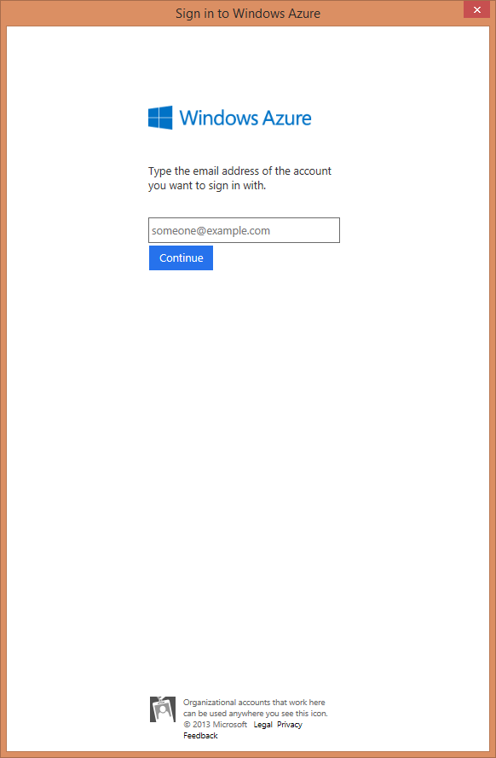
Implicit Flow
Azure AD
Authorization
Endpoint
https://login.microsoftonline.com/
[..]/oauth2/authorize
Token
Endpoint
https://login.microsoftonline.com/
[tenantid]/oauth2/token
Endpoint
https://graph.microsoft.com
User + Native Application
1. Request token (Client Id, resource=“https://graph.microsoft.com”)
2. Sign in
User sees
web pop up
3. Returns Auth Code to Redirect URI

Slide 43
Implicit Flow
Azure AD
Authorization
Endpoint
https://login.microsoftonline.com/
[..]/oauth2/authorize
Token
Endpoint
https://login.microsoftonline.com/
[tenantid]/oauth2/token
Endpoint
https://graph.microsoft.com
User + Native Application
4. Redeem Auth Code (Auth Code, Client ID, Redirect URI, resource=“https://graph.microsoft.com”)
5. Returns Access Token(JWT), Refresh Token (JWT)
6. Request token + AAD Access Token in Authorization Header (Client ID)
7. Returns Access Token(JWT)
8. Issue query with Access Token in Authorization Header

Slide 44
Comparing Different OAuth Flows
OAuth Flow | Supports App-Only | Supports User+App | Requires User Involvement
Resource Owner Password | - | yes | -
Client Credentials | yes | - | -
Auth Code | - | yes | yes
Implicit | - | yes | yes

Slide 45
Demo
OAuth Sandbox
https://oauthplay.azurewebsites.net/
Notes:
Click on the authorize your own account
Accept the permissions. Explain the scopes
Click get tokens to exchange the code for tokens
Show the tokens
Copy the access token and navigate to jwt.io. Or coderstoolbox.net Decode the token
Paste the token in PostMan to show that it is a high privilege token
Select a query and call the graph. NOTE This is a V1 graph but the process is the same for the tokens

Slide 46
The Microsoft Graph

Slide 47





State of the world before Microsoft Graph
Work and school
Personal
Many different APIs to access data
Separate auth stacks for work and personal

Slide 48
Diverse API styles and endpoints
Azure Active Directory Graph API
https://graph.windows.net/contoso.com/users
https://graph.windows.net/contoso.com/groups
Windows Live profile API
https://apis.live.net/v5.0/me
SharePoint User Profile API
https://contoso.sharepoint.com/_api/SP.UserProfiles.PeopleManager/GetMyProperties
Exchange HD Picture API
https://graph.microsoft.com/v1.0/me/photo
Outlook REST API
https://outlook.office.com/api/v2.0/me/Messages
https://outlook.office.com/api/v2.0/me/Events
Office Graph in SharePoint Online
https://contoso.sharepoint.com/_api/search/query?Querytext='*'&Properties='GraphQuery:actor(ME,action\:1020,or(action\:1020\,action\:1003,action\:1001,action\:1024,action\:1005,action\:1037,action\:1039,action\:1036)'&SelectProperties='Docid,Title
OneDrive for Business API
https://contoso-my.sharepoint.com/personal
/yina_contoso_com/_api/v2.0/drive
https://contoso.sharepoint.com/sites
/designCouncil/_api/v2./drive
OneDrive API
https://api.onedrive.com/v1.0/drive

Slide 49
Today’s world with Microsoft Graph
Microsoft Graph
https://graph.microsoft.com
Work and school
Personal
…

Slide 50
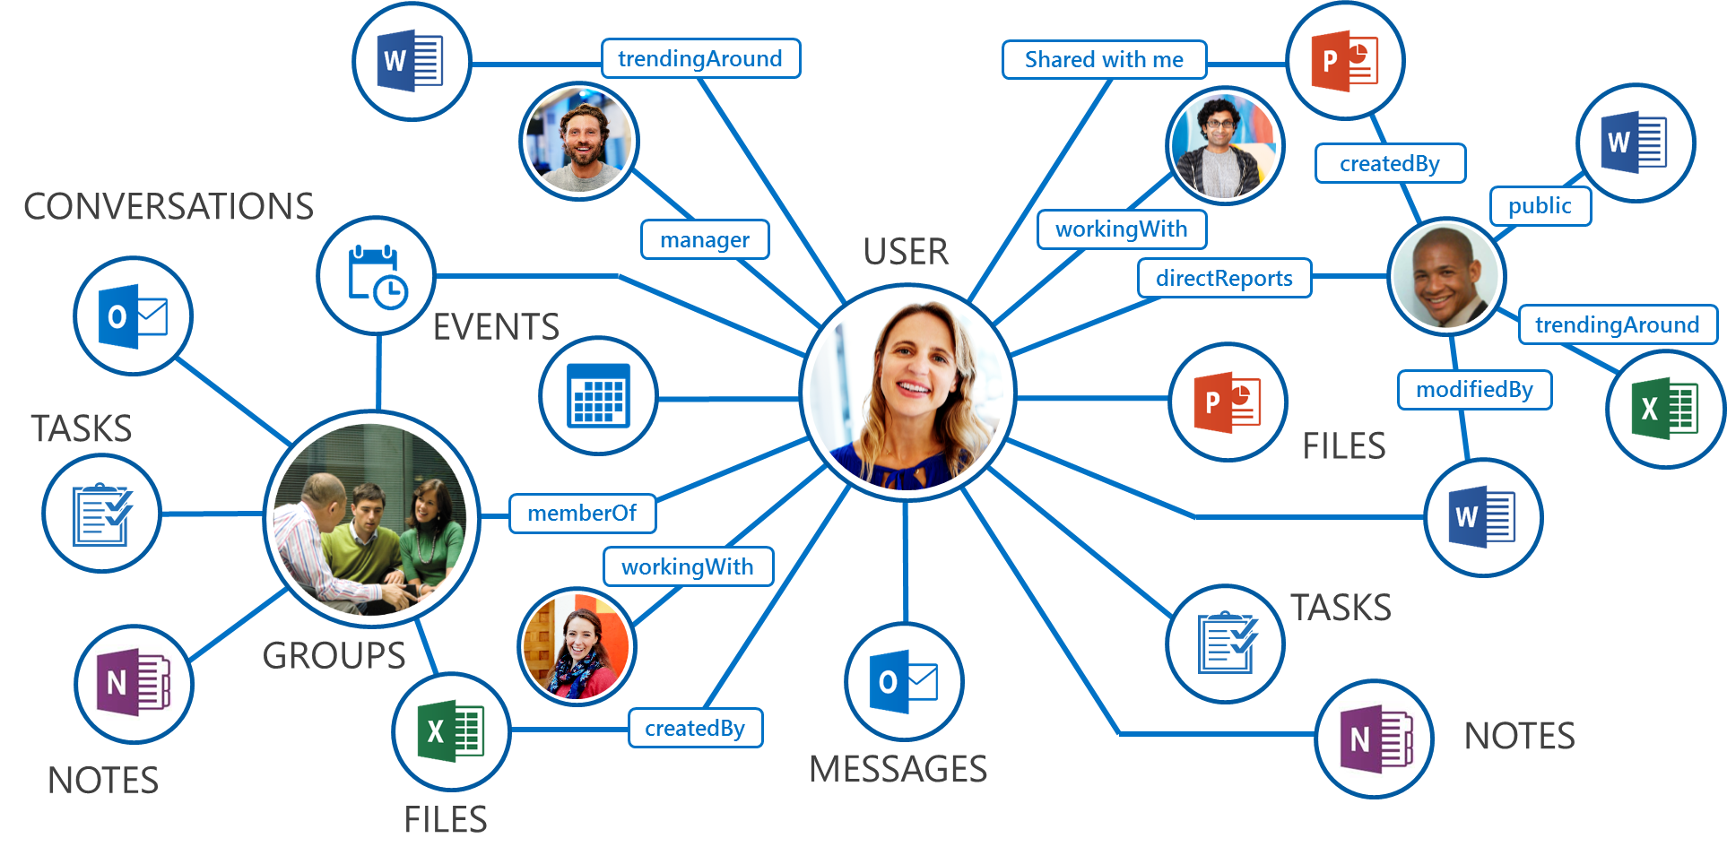
What is Microsoft Graph?
Single API for:
Accessing data
  /me, /users, /groups, /messages, /drive, ….
Traversing data
  /drive/items/<id>/lastmodifiedByUser
Accessing insights
  /insights/trending
Work/School and Personal
https://graph.microsoft.com/

Slide 51
Profile API
Get and update your own profile information
  The /me API allows you to get and update your own profile information regardless of where different properties are stored.
Get profile information about other users
  The /users API allows you to get information about other users in your tenancy.
See how people are related
  Traverese the organisation structure using manager and directReports
manager
/me
/users
directReports

Slide 52
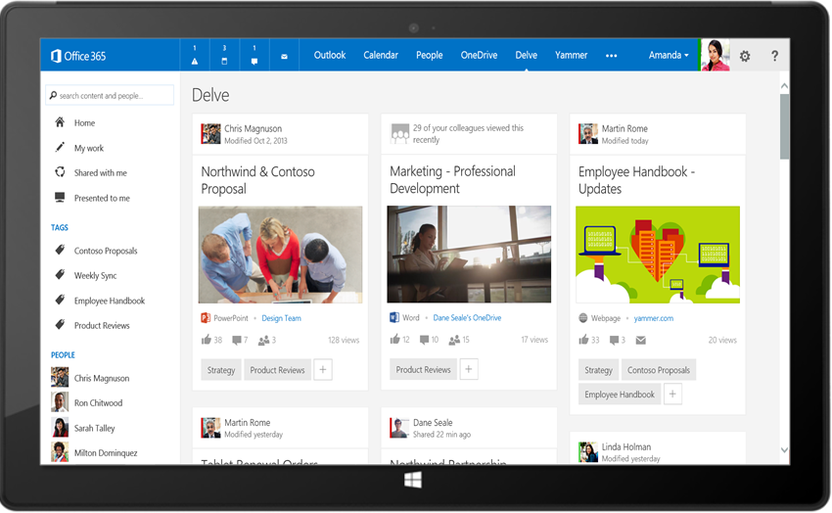
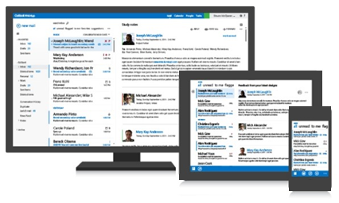


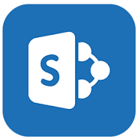

Intelligence in Microsoft Graph
Your
App
Microsoft Graph API (graph.microsoft.com)
USERS
GROUPS
FILES
MAIL
CALENDAR
TASKS
Microsoft Graph rich relationships and insights

Slide 53


Robust Microsoft Graph APIs
Designed for
openness and
flexibility
Enabling a
consistent
development
platform
Powering
a world
of devices
https://graph.microsoft.com
Files
Mail
Calendar
People
Search
Office Graph
Groups
Notebooks
Videos
Social

Slide 54
Unified API style – single endpoint
https://graph.microsoft.com
Operation | Service endpoint
GET my profile | https://graph.microsoft.com/v1.0/me
GET my files | https://graph.microsoft.com/v1.0/me/drive/root/children
GET my photo | https://graph.microsoft.com/v1.0/me/photo/$value
GET my mail | https://graph.microsoft.com/v1.0/me/messages
GET my calendar | https://graph.microsoft.com/v1.0/me/calendar
GET my manager | https://graph.microsoft.com/v1.0/me/manager
GET last user to modify file foo.txt | https://graph.microsoft.com/v1.0/me/drive/root/children/foo.txt/lastModifiedByUser
GET users in my organization | https://graph.microsoft.com/v1.0/users
GET group conversations | https://graph.microsoft.com/v1.0/groups/<id>/conversations
GET people related to me | https://graph.microsoft.com/beta/me/people
GET my tasks | https://graph.microsoft.com/beta/me/tasks
GET my notes | https://graph.microsoft.com/beta/me/notes/notebooks
GET files trending around me | https://graph.microsoft.com/beta/me/insights/trending

Slide 55
APIs Available in V2.0
Azure AD
  Users
  Groups
  Directory
  Applications / Service Principals
  Privileged Identity Management
  Identity Protection
WebHooks for Outlook data
SharePoint & LiveID profiles
Office
  OneDrive
  Excel
  Mail
  Calendar
  Tasks
  People
OneDrive
  Drives and files
Coming Soon
  OneNote
  Skype for Business

Slide 56
Functionality Available
OData query parameters
    $select
    $expand
    $orderby
    $filter
    $top
    $skip
    $skipToken
    $count
Webhooks (change notifications)
    Messages
    Events
    Contacts
    Group Conversations
Data Extensions
OAuth 2.0 permission scopes- delegated and application permissions
AppModel v2 auth endpoint support

Slide 57
Demo
Query the graph https://graphexplorer2.azurewebsites.net/
Notes:
Navigate to https://graph.microsoft.io/
Click on try the api and sign in
Issue some queries
https://graph.microsoft.com/v1.0/me
https://graph.microsoft.com/v1.0/me/memberof
Filter the query: https://graph.microsoft.com/v1.0/me/memberof?$select=displayName
Get email: https://graph.microsoft.com/v1.0/me/mailfolders/inbox/messages?$select=subject&top=10
Get groups: https://graph.microsoft.com/v1.0/groups

Slide 58
Code Samples

Slide 59
Profile API demo – Experience and API
graph.microsoft.com/v1.0/
GET /me?$select=displayName,aboutMe,jobTitle,skills
PATCH /me
GET /me/manager
GET /users/{id}
GET /users/{id}/manager
GET /users/{id}/directReports

Slide 60
Provisioning Groups with Graph
var g = new Group {
DisplayName = "My Group",
MailNickname = "MyGroup",
SecurityEnabled = false,
MailEnabled = true,
Description = "A nice group",
GroupTypes = new[] { "Unified" },
};
g = await graphService.Groups.Request().AddAsync(g);

Slide 61

Read data from existing SharePoint site
GET https://graph.microsoft.com/beta/sites/ {siteId}/lists/{listId}/items?expand=columnSet
{ "value":[ {
"createdBy": { "user" : {"id":"d54e4cdd-d2ca-4c39-bfa5-35895bca12f0","displayName":"Gareth"}},
"createdDateTime":"2016-09-20T08:16:21Z",
"eTag":"1610ac6a-24f6-4458-9733-1e5977c63caa,1",
"id":"1610ac6a-24f6-4458-9733-1e5977c63caa",
"lastModifiedBy":{"user":{"id":"d54e4cdd-d2ca-4c39-bfa5-35895bca12f0","displayName":"Gareth"}},
"lastModifiedDateTime":"2016-09-0T08:16:21Z",
"webUrl":"https://site.sharepoint.com/sites/SuiteLevelAppDemo/Lists/NewHireTasks/1_.000",
"listItemId":1,
"columnSet":{
"Title":"Set up payroll details",
"Description":"Set up your payroll details for direct payment of your salary.",
"id":"1",
...
} }]}

Slide 62
Provisioning Sites with CSOM
var tenant = new Tenant(clientContext); var spoOperation = tenant.CreateSite(new SiteCreationProperties
{
  Url = "https://<tenant>.sharepoint.com/sites/<siteName>",
  Owner = "user@tenant.com",
  Template = "BLANKINTERNETCONTAINER#0",
  Title = "Contoso Property Management Dashboard",
  StorageMaximumLevel = 1000,
  StorageWarningLevel = 750,
  TimeZoneId = 7,
  UserCodeMaximumLevel = 550,
  UserCodeWarningLevel = 500
  });
clientContext.Load(spoOperation);
clientContext.ExecuteQuery();

Slide 63

Create a plan for new employee tasks
POST https://graph.microsoft.com/beta/plans
{
"title" : "My plan with Bob",
"owner" : "<groupIdGuid>"
}
POST https://graph.microsoft.com/beta/buckets
{
"name" : "Urgent",
"planId" : "<planId>" // From response to previous call
}

Slide 64

Update latest timesheet data
GET https://graph.microsoft.com/1.0/me/drive/
items/<id>/workbook/worksheets
PATCH https://graph.microsoft.com/beta/me/drive/
items/{itemId}/workbook/worksheets('Time')/
range(address='a2:c2')
{
…
"values": [ ["EmployeeHours", "March", "32.0"]],
"valueTypes": [ ["String", "String", "Double"]],
…
}

Slide 65
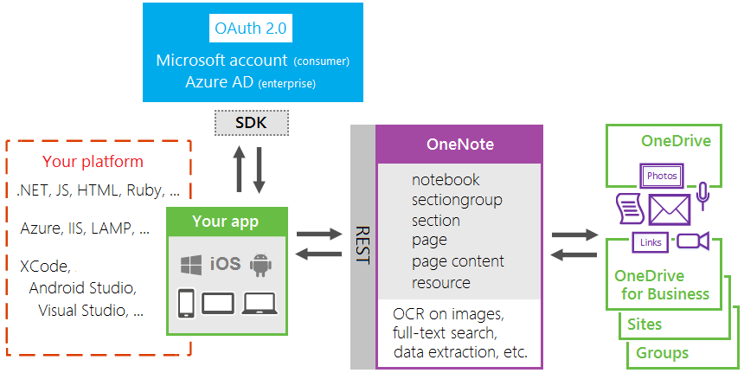
OneNote HTTP REST APIs
http://dev.onenote.com
https://github.com/OneNoteDev

Slide 66

API Documentation
API docs are open source on GitHub.
Automated testing
  Every change to the docs is tested w/ the service to ensure the docs are accurate
  Every change to our service is tested to verify it doesn’t break the docs

Slide 67
Questions?

Slide 68
HOL Summary
OAuth authentication for web applications with Azure AD.
Querying the Microsoft Graph for extended details about a given user.
Using the Graph to send an email message as an example. This can be applied to calendar events and tasks.

