Slide 1
DevOps

Slide 2
Agenda
DevOps with the Microsoft cloud
Building a DevOps pipeline
Enhancing mobile development

Slide 3
Why DevOps?
Isn’t DevOps another phrase for Agile?
Who is responsible for deploying code?
When deployments fail, who gets blamed?
How many production deployments do you perform per year? Month? Day? Hour?
What is stopping you from deploying faster?

Slide 4


Traditional Development + Operations
DEV
OPS

Slide 5

What is DevOps?
“It’s a job title”
“It’s Development and
Operations collaboration”
“It means faster and smaller releases”
“It’s automation”

Slide 6






The DevOps conversation
DEV
OPS
1
People
2
Process
3
Products
Notes:
People = Culture
Fundamental attributes of successful cultures:
Shared mission and incentives: infrastructure as code, apps as services, DevOps/all as teams
You need to consider your hardware as a commodity, (don't give your servers names) , servers are like farm animals, it is just harder if you name them
Build deep instrumentation into services, push complexity up the stack
Rally around agile, shared metrics, CI, service owners on call, etc.
Changing the culture: any change takes time, changing culture is no exception and you can't do it alone, exploit compelling events to change culture: downtimes, cloud adoption, devops buzz
PROCESS
Definition and design, compliance, and continuous improvement
PEOPLE
Responsibilities, management, skills development, and discipline
Products
Tools and infrastructure

Slide 7
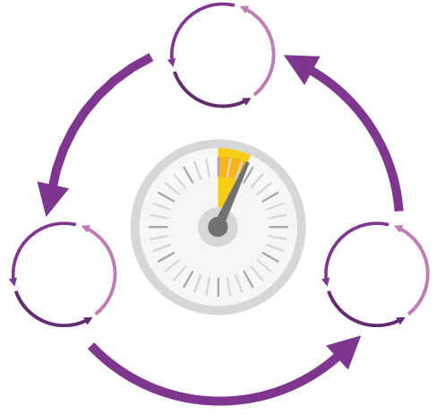
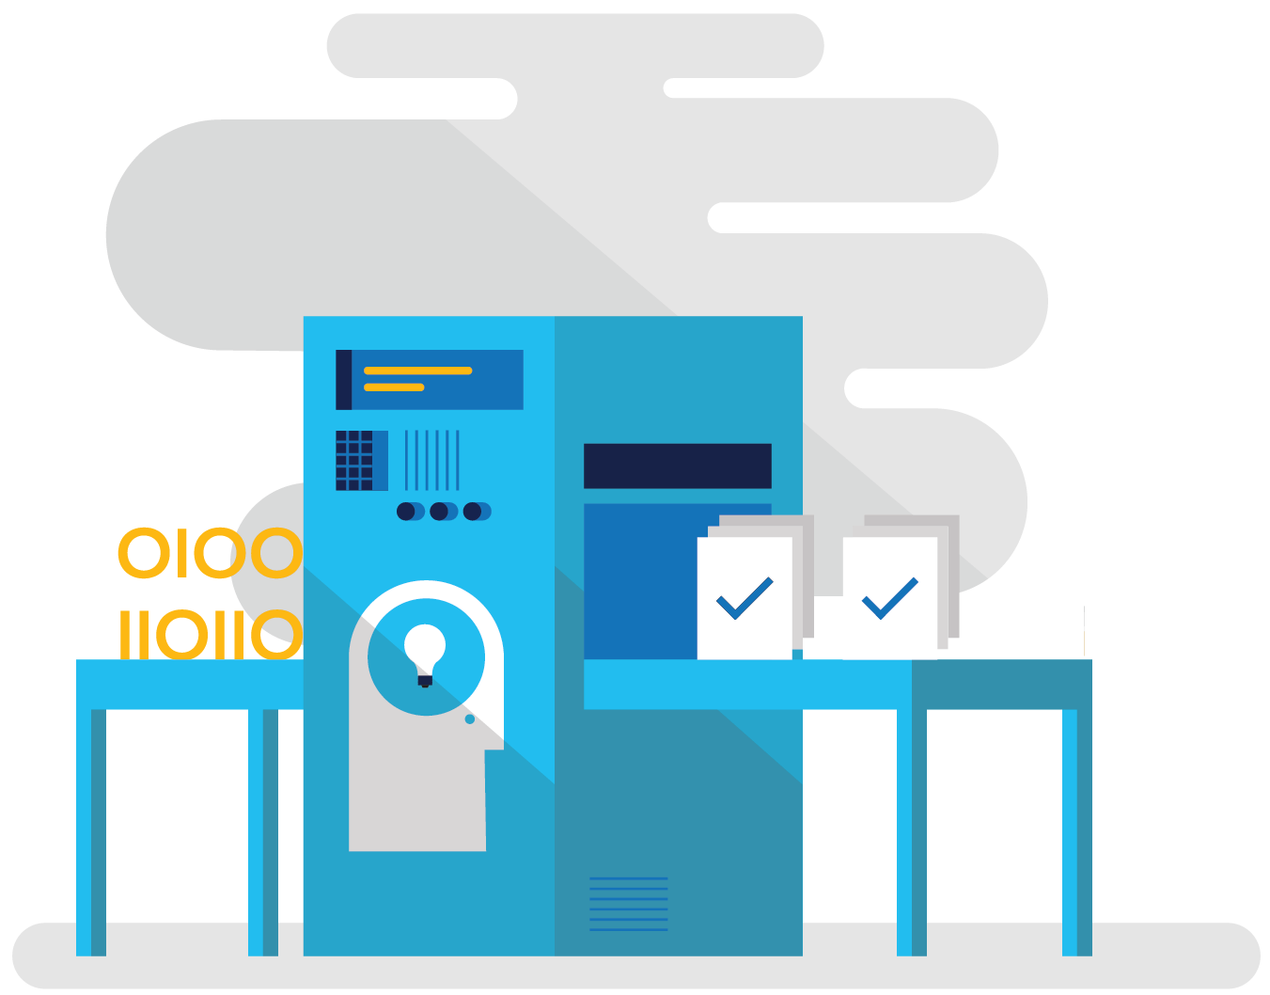
How DevOps can help
Shorten Cycle Times
Optimize Resources
Improve Quality
and Availability
Speed up and increase traceability of each release by empowering your development and operations teams with advanced collaboration and automation tools.
Efficiently manage environments using technologies that support self-service provisioning in a secure way, in line with your IT governance standards.
Capture rich telemetry on application performance and usage so that you can make better decisions on future investments and anticipate issues in production before they impact your service.

Slide 8
DevOps habits and practices
PRACTICES
Infrastructure as Code
Continuous Deployment
Release Management
Configuration Management
Automated Recovery
PRACTICES
Automated Testing
Continuous Integration
Continuous Deployment
Release Management
PRACTICES
Usage Monitoring
Telemetry Collection
Testing in Production
Stakeholder Feedback
PRACTICES
Code Reviews
Automated Testing
Continuous Measurement
FLOW OF
CUSTOMER VALUE
TEAM
AUTONOMY
& ENTERPRISE
ALIGNMENT
BACKLOG refined with LEARNING
EVIDENCE
gathered in PRODUCTION
MANAGED TECHNICAL
DEBT
PRODUCTION
FIRST MINDSET
INFRASTRUCTURE
is a FLEXIBLE RESOURCE
PRACTICES
Enterprise Agile
Continuous Integration
Continuous Deployment
Release Management
PRACTICES
Testing in Production
Usage Monitoring
User Telemetry
Stakeholder feedback
Feature flags
PRACTICES
Application Performance Management
Infrastructure as Code
Continuous Delivery
Release Management
Automated Recovery

Slide 9
Four focus areas
1
4
Plan
Monitor + Learn
Development
Production
2
3
Develop + Test
Release

Slide 10
Building a DevOps pipeline

Slide 11
Plan + Track
Project starts
Manage work
Develop + Test
1
Track progress
Plan

Slide 12
Plan + Track
Agile planning tools
Governance for development teams
Visualizations through dashboards and charts
Choice of Git or TFVC
Unlimited free private repositories

Slide 13
Develop + Test
2
Write Code
Unit Testing
Version Control
Build
Build Verification
Release

Slide 14
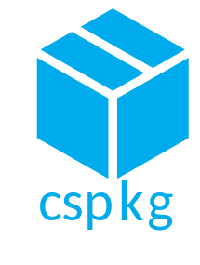



Continuous Integration
Source
Build
Value
Accelerate Delivery
Repeatability
Optimized Resources
Test
Measure
Deployment Lead Time
MTTR
MTTD
DEV
OPS

Slide 15
Continuous Testing
Testing Software
Value
Accelerate Delivery
Repeatability
Optimized Resources
X
Measure
Deployment Lead Time
MTTR
MTTD
DEV
OPS

Slide 16
Building with agents
Custom build agents extend the default Hosted agent
Pool sets of agents to build in parallel
Agent is cross platform
Cross-platform agent runs on-premises or in the cloud

Slide 17

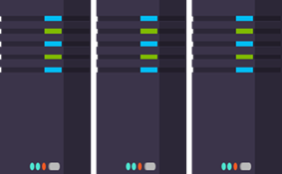
Release
Cloud
Load Testing
Integration testing
environment
Staging
environment
3
Monitor + Learn
Automated functional testing environment
Pre-production environment

Slide 18

Continuous Delivery
SOURCE & BUILD
QA ENVIRONMENT
Value
Optimized Resources
Accelerate Delivery
Measure
Deployment Frequency
MTTR
Availability
DEV
OPS

Slide 19
Release Management
SOURCE REPO
DEV
Value
Optimized Resources
Accelerate Delivery
STAGE
Measure
Deployment Frequency
MTTR
Availability
PRODUCTION
DEV
OPS

Slide 20
Infrastructure as Code
DEV
Value
Optimized Resources
Accelerate Delivery
STAGE
Measure
Deployment Rate
MTTR
OPS
PRODUCTION
DEV
OPS

Slide 21
Monitor + Learn
Plan the next iteration
Feedback
Monitor
4

Slide 22
Monitor + Learn
Telemetry at every tier
Performance and load testing
Automated notifications for anomalies

Slide 23
Deployment slots
Swaps staged deployments
Called a Virtual IP or VIP swap as it swaps the addresses of two deployments
No downtime during VIP swap
  Sites are warmed up behind the scenes prior to swap

Slide 24
Demo
Create sample application with CI
Notes:
Open VS
Open VSTS
Create app
Check it in
Enable CI build
Show the dashboard, tasks
Show the build log
Show the build tasks

Slide 25
Enhancing mobile development

Slide 26




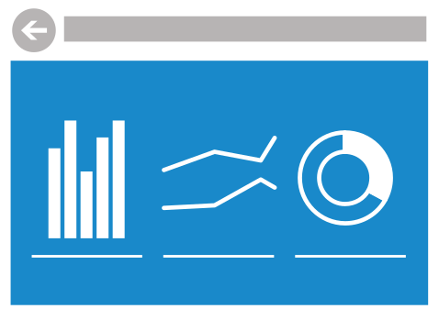
CI + CD for a mobile world
Code Repository
Build + Deploy
Automated Testing
User Testing
Backlog
Monitor and improve

Slide 27
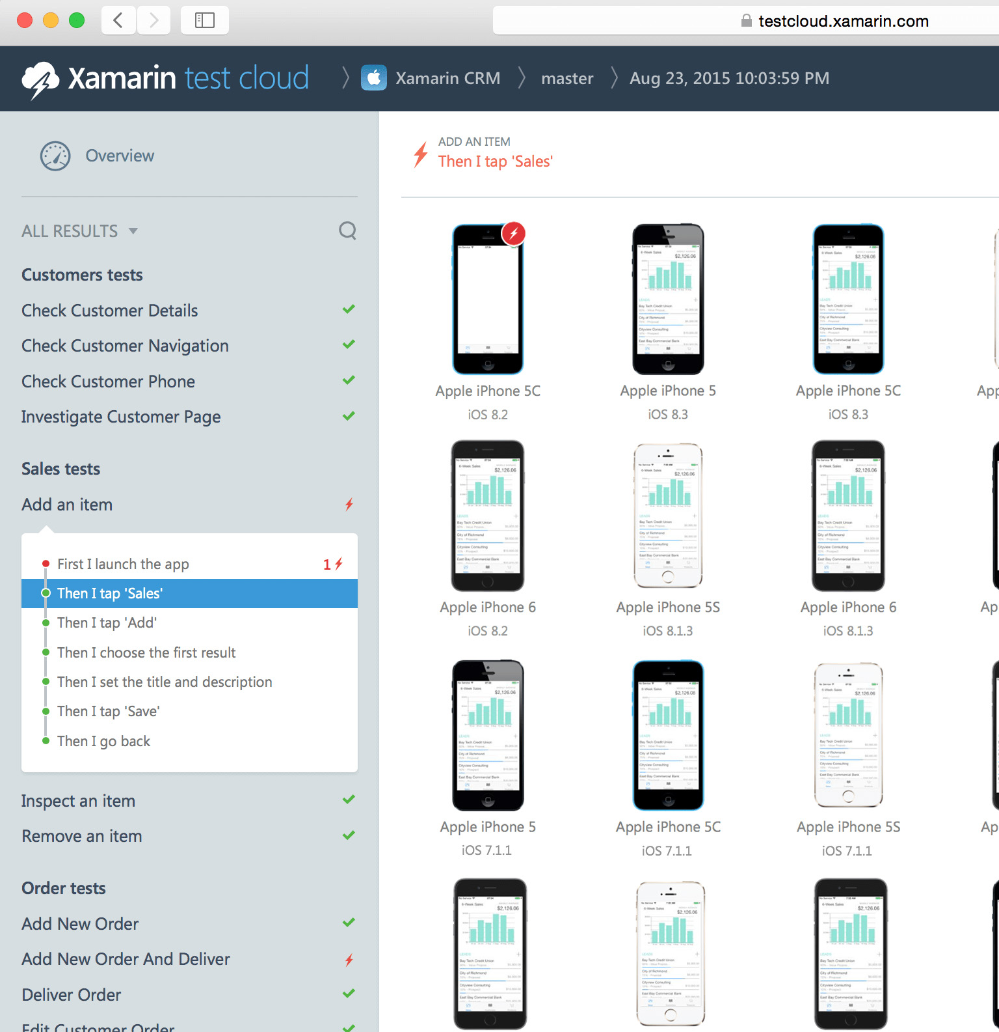
Xamarin Test Cloud
2000+ Devices
  Automate your app testing and run them on over 2,000 different real devices. Test everything users do, as well as any performance problems with step-by-step memory and performance tracking.
Real devices, real quality
  Ensure higher quality by testing on real devices
  Use C#, Ruby, or Cucumber to build automated tests
  Integrates with any continuous integration system

Slide 28
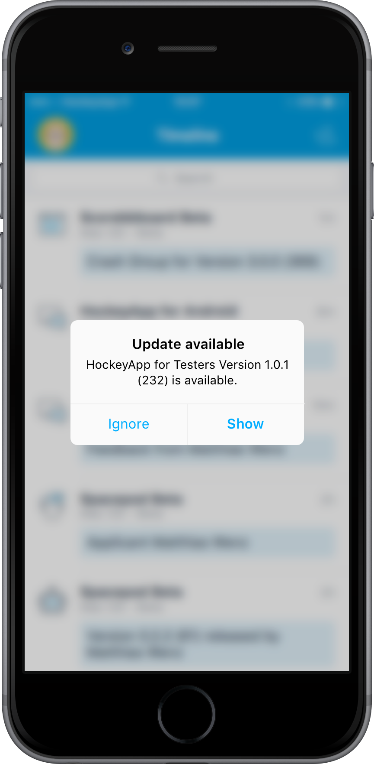
HockeyApp Beta Distribution
In-house App Store for testers
  Upload betas of your application to the HockeyApp store to allow testers to install and test beta versions on actual devices
Deployment made easy
  HockeyApp’s desktop application automatically tracks all necessary information about your latest build in order to make uploading beta versions easy.
User Feedback Management
  All feedback is handled as discussions. Search discussions, mark them as completed or create work items based on them. Give your users a voice outside of the app store.

Slide 29






Microsoft
Tooling
People | Process | Tools
Developer IDE
Build/CI
Release/CD
Develop
Monitor
Build + Test
Deploy
Team Collaboration
Release Management
for Visual Studio
Test
Monitor + Learn
Automation Service
PowerShell | WAML
Azure Resource Management
Application Insights
Microsoft Test Manager
xPlat Command Line

Slide 30
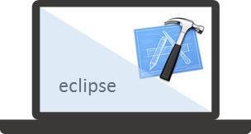


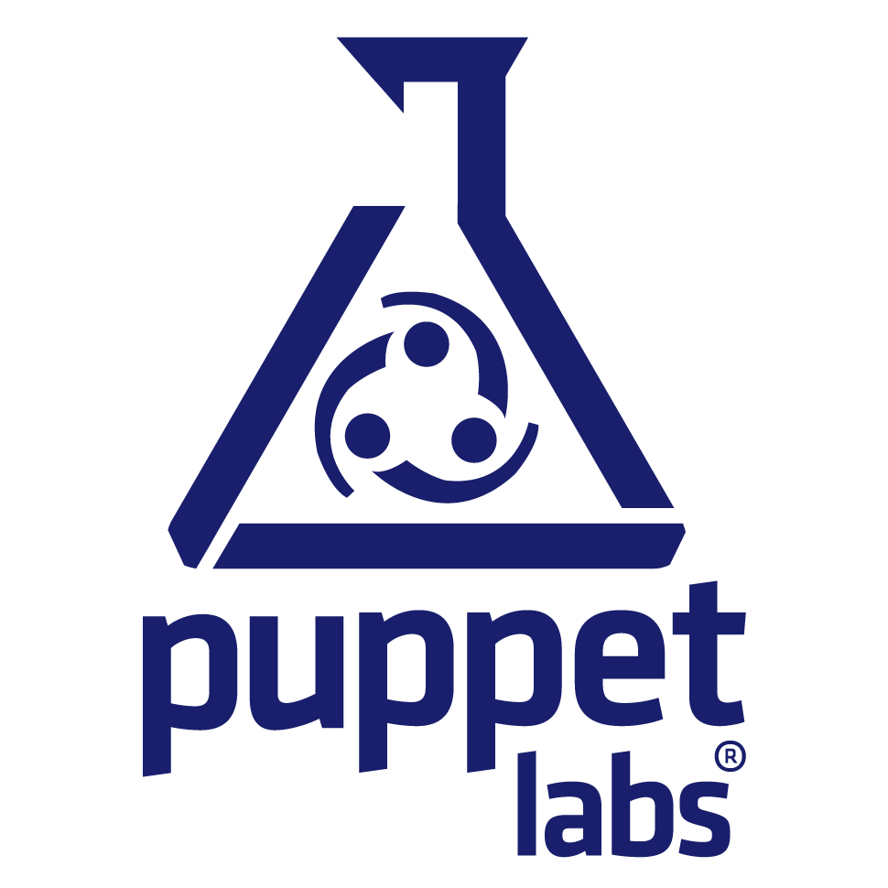




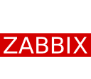



OSS
Tooling
People | Process | Tools
Developer IDE
Build/CI
Configuration
Develop
Monitor
Build + Test
Deploy
Team Collaboration
Release
Monitor + Learn
Test

Slide 31
Summary
People, Process, and Tools are equally important
DevOps produces higher quality applications, more quickly, to users of any form factor
Visual Studio Team Services offers a flexible, extensible pipeline spanning from planning to delivery

Slide 32
HOL Summary
Created a Visual Studio Team Services online account for code version control, automatic compiling and deploying of a web app.
Created a VSTS Git repository for synchronizing source code on a local machine and in the cloud.
Created a Continuous Integration pipeline that automatically compiles an application and creates packages for deployment anytime code is checked into the repository.
Deployed a built application to an Azure Web App from VSTS and thus automating the final steps of the deployment process.

